Slide 1
DEEP LEARNING

Slide 2
Self driving car
Google Home devices: Alexa and Siri
Amazon and Apple's digital voice assistants,
Text-to-speech synthesis
Language identification
English-to-French translation (Google, 2014)
Arabic handwriting recognition
Optical character recognition
Image caption generation
Video-to-textual description (Annotations to video)
Syntactic parsing for natural language processing

Slide 3

Some more examples of applied deep learning include the following:
Automated image sharpening
Automating image upscaling
WaveNet: generating human speech that can imitate anyone’s voice
Speech reconstruction from silent video
Image autofill for missing regions
Automated image captioning (process of generating textual description from an image)
Turning hand-drawn doodles into stylized artwork (Doodle means a rough drawing)

Slide 4
AI, ML, DL and DS

Slide 5
AI, ML, DL and DS
Venn Diagram
Artificial intelligence
AI: is just a program or machine's ability to learn and think for itself, in such a way that it is capable of developing skills as it practices and gains experience. Its purpose is to support and enhance human activities.
Enable the m/c to think with out any human intervention, and take decision.
This is the final goal like Self driving car, Google Home devices: Alexa and Siri, Amazon and Apple's digital voice assistants, are very real applications of AI.
Artificial intelligence (AI) is an area of computer science that emphasizes the creation of intelligent machines that work and react like humans.
Some of the activities computers with artificial intelligence are designed for include: Speech recognition, Learning, Planning.
Artificial intelligence, or AI, is the use of programming to imitate human thought and action by analyzing data and surroundings, solving problems and learning or self-teaching to familiarize to a variety of tasks.

Slide 6
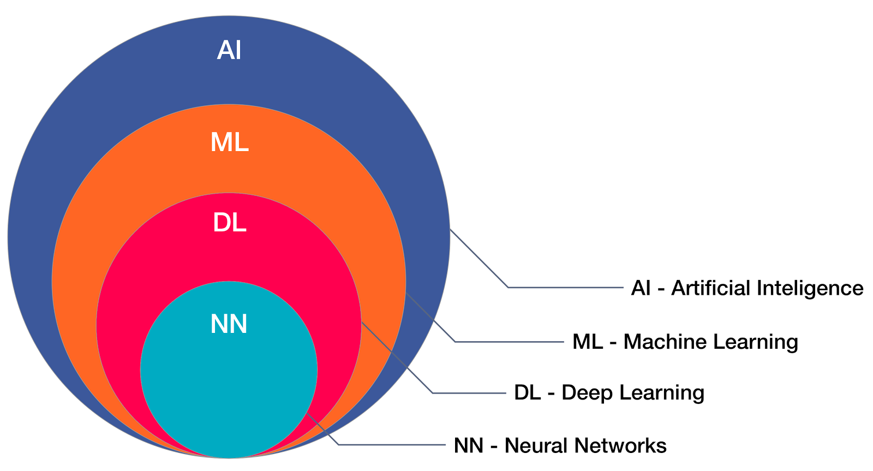

Slide 8
AI, ML, DL and DS
Machine Learning
ML: M/C learning is the subset of AI.
It provides statistical tools to explore and analyze the data.
ML is a method of data analysis that automates analytical model building. It is a branch of AI based on the idea that systems can learn from data, identify patterns and make decisions with minimal human intervention.
Machine learning focuses on the development of computer programs that can access data and use it to learn for themselves.

Slide 10
AI, ML, DL and DS
Neural networks
NN: make use of neurons that are used to transmit data in the form of input values and output values. They are used to transfer data by using networks of connections.
Artificial neural networks (ANNs) are machine learning techniques which simulate the mechanism of learning biological organisms.
Artificial Neural networks consist of up to 3 layers namely
I/P layer
Hidden Layer
O/P layer

Slide 12
AI, ML, DL and DS
Deep learning
DL: composed of several hidden layers while neural networks consist of up to 3 layers.
DL is the subset of ML. This got created for the M/C to learn to think how actually human brain learn to think.
In DL, we create architecture called multi-neural network architecture. Idea of Deep neural network is to mimic human brain.
Eg: Neural Network and Deep Learning lies in the heart of products such as self driving cars, image recognition software etc.

Slide 14
AI, ML, DL and DS (Contd..)
In deep Learning, we have 3 techniques:
ANNs : Problems that involved with the numbers are solved with the help of ANN.
Convolution Neural Networks (CNN) : If the i/p is in images, then we use CNN. Advanced CNN known as Transfer learning.
Recurrent Neural Networks (RNN) : If data is time series kind of data, we use RNN.

Slide 15
AI, ML, DL and DS
Date Science
DS: will work on all above AI, ML, DL using mathematical tools such as statistics, probability, Linear algebra, Differential calculus etc.

Slide 16
Introduction to Neural Networks

Slide 17
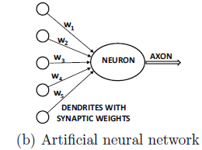
1.1 Introduction (From Charu)
Artificial Neural Networks (ANNs) are m/c learning techniques which simulate the mech of learning biological organisms.
The human nervous system contains cells, referred as neurons.
Fig.1.1 Biological neural network
Fig 1.1(b) Artificial neural network
Neurons are connected to one another with the use of axons and dendrites,
and the connecting regions between axons and dendrites are referred to as synapses. (See Fig. 1.1(a)).
The strengths of synaptic connections often change in response to external stimuli.
This change is how learning takes place in living organisms.
This biological mechanism is simulated in ANNs, which contain computation units that are referred to as neurons.
“Neural networks” to refer ANNs.
The computational units are connected to one another through weights, which serve the same role as the strengths of synaptic connections in biological organisms.
Each input to a neuron is scaled with a weight, which affects the function computed at that unit. This architecture is illustrated in Figure 1.1(b).

Slide 18
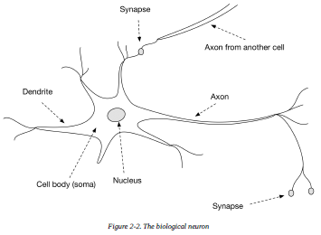
1.1 Introduction
Artificial neural networks (ANNs) are m/c learning techniques which simulate the mech of learning biological organisms.
The human nervous system contains cells, referred as neurons.
Fig 1.1(b) Artificial neural network
Fig.1.1 Biological neuron
Neurons are connected to one another with the use of axons and dendrites,
and the connecting regions between axons and dendrites are referred to as synapses. (See Fig. 1.1(a)).
The strengths of synaptic connections often change in response to external stimuli.
This change is how learning takes place in living organisms.
This biological mechanism is simulated in ANNs, which contain computation units that are referred to as neurons.
“Neural networks” to refer ANNs.
The computational units are connected to one another through weights, which serve the same role as the strengths of synaptic connections in biological organisms.
Each input to a neuron is scaled with a weight, which affects the function computed at that unit. This architecture is illustrated in Figure 1.1(b).

Slide 19
An ANN computes a function of the inputs by propagating the computed values from the input neurons to the output neuron(s) and using the weights as intermediate parameters.
Learning occurs by changing the weights connecting the neurons.
Just as external stimuli are needed for learning in biological organisms, the external stimulus in artificial neural networks is provided by the training data containing examples of input-output pairs of the function to be learned. For eg, the training data might contain pixel representations of images (input) and their annotated labels (e.g.,
carrot, banana) as the output.
These training data pairs are fed into the neural network by using the input representations to make predictions about the output labels.
The training data provides feedback to the correctness of the weights in the neural network depending on how well the predicted output (e.g., probability of carrot) for a particular input matches the annotated output label in the training data.
One can view the errors made by the neural network in the computation of a function as a kind of unpleasant feedback in a biological organism, leading to an adjustment in the synaptic strengths.
Similarly, the weights between neurons are adjusted in a neural network in response to prediction errors.
The goal of changing the weights is to modify the computed function to make the predictions more correct in
future iterations.
Therefore, the weights are changed carefully in a mathematically justified way so as to reduce the error in computation on that example.
By successively adjusting the weights between neurons over many input-output pairs, the function computed by the neural network is refined over time so that it provides more accurate predictions.
Therefore, if the neural network is trained with many different images of bananas, it will eventually be able to properly recognize a banana in an image it has not seen before.
This ability to accurately compute functions of unseen inputs by training over a finite set of input-output pairs is referred to as model generalization. The primary usefulness of all machine learning models is gained from their ability to generalize their learning from seen training data to unseen examples.

Slide 20
1.1 Introduction (Contd..)
An ANN computes a function of the inputs by
propagating the computed values from the input neurons to the output neuron(s) and
using the weights as intermediate parameters.
Learning occurs by changing the weights connecting the neurons.
Just as external stimuli are needed for learning in biological organisms, the external stimulus in ANNs is provided by the training data containing examples of input-output pairs of the function to be learned. For eg, the training data might contain pixel representations of images (input) and their interpreted labels (e.g.,carrot, banana) as the output.
These training data pairs are fed into the neural network by using the input representations to make predictions about the output labels.
The training data provides feedback to the correctness of the weights in the neural network depending on how well the predicted output (e.g., probability of carrot) for a particular input matches the annotated output label in the training data.
One can view the errors made by the neural network in the computation of a function as a kind of unpleasant feedback in a biological organism, leading to an adjustment in the synaptic strengths.
IIIly, the weights b/n neurons are adjusted in a neural network in response to prediction errors.

Slide 21
1.1 Introduction (Contd..)
The goal of changing the weights is to modify the computed function to make the predictions more correct in future iterations.
Therefore, the weights are changed carefully in a mathematically justified way, so as to reduce the error in computation on that example.
By successively adjusting the weights between neurons over many input-output pairs, the function computed by the neural network is refined over time so that it provides more accurate predictions.
Therefore, if the neural network is trained with many different images of bananas, it will eventually be able to properly recognize a banana in an image it has not seen before.
This ability to accurately compute functions of unseen inputs by training over a finite set of input-output pairs is referred to as model generalization. The primary usefulness of all machine learning models is gained from their ability to generalize their learning from seen training data to unseen examples.

Slide 22
1.1 Introduction (Contd..)
The principles of neuroscience have often been useful in designing neural network architectures.
The neural networks are built as higher-level abstractions of the classical models that are commonly used in machine learning.
In fact, the most basic units of computation in the neural network are inspired by machine learning algorithms like least-squares regression and logistic regression.
Neural networks gain their power by putting together many such basic units, and learning the weights of the different units jointly in order to minimize the prediction error.
From this point of view, a neural network can be viewed as a computational graph of basic units in which greater power is gained by connecting them in particular ways.
When a neural network is used in its most basic form, without connecting together multiple units, the learning algorithms often reduce to classical machine learning models..

Slide 23
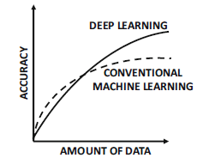
1.1 Introduction (Contd..)
The real power of a neural model over classical methods is known when these elementary computational units are combined, and the weights of the elementary models are trained using their dependencies on one another.
By combining multiple units, one is increasing the power of the model to learn more complicated functions of the data than the elementary models of basic machine learning.
Sufficient training data is also required in order to learn the larger number of weights in these expanded computational graphs.

Slide 24
Neural Networks (From Josh)
Neural networks are a computational model that shares some properties with the animal brain in which many simple units are working in parallel with no centralized control unit. The weights between the units are the primary means of long-term information storage in neural networks. Updating the weights is the primary way the neural network learns new information.
In equation Ax = b, in the context of neural networks, the A matrix is still the input data and the b column vector is still the labels or outcomes for each row in the A matrix.
The weights on the neural network connections becomes x (the parameter vector).
The behavior of neural networks is shaped by its network architecture. A network’s architecture can be defined (in part) by the following:
Number of neurons
Number of layers
Types of connections between layers
The most well-known and simplest-to-understand neural network is the feedforward multilayer neural network. It has an input layer, one or many hidden layers, and a single output layer. Each layer can have a different number of neurons and each layer is fully connected to the adjacent layer. The connections between the neurons in the layers form an acyclic graph, as in
Figure 2-1.

Slide 25
Neural Networks (From Josh)
Neural networks are a computational model that shares some properties with the animal brain in which many simple units are working in parallel with no centralized control unit.
The behavior of neural networks is shaped by its network architecture.
A network’s architecture can be defined by the following:
Number of neurons
Number of layers
Types of connections between layers
The most well-known and simplest-to-understand neural network is the feedforward multilayer neural network.
It has an input layer, one or many hidden layers, and an output layer.
Each layer can have a different number of neurons and each layer is fully connected to the adjacent layer.

Slide 26
The Biological Neuron (Contd..)
From biological to artificial
The animal brain has been shown to be responsible for the fundamental components of the mind. We can study the basic components of the brain and understand them. Research has shown ways to map out functionality of the brain and track signals as they move through neurons.
However, we still do not completely understand how this collection of decentralized functional units provides the foundation for thought and the seat of consciousness.
Now that we’ve established the basics of how a biological neuron works, let’s take a look at the first attempts at modeling the neuron with the beginning of the perceptron.
The Perceptron
The perceptron is a linear model used for binary classification. In the field of neural networks the perceptron is considered an artificial neuron using the The predecessor to the perceptron was the Threshold Logic Unit (TLU), which could learn the AND and OR logic functions. The perceptron training algorithm is considered a supervised learning algorithm. Both the TLU and the perceptron were inspired by the biological neuron as we’ll explore.

Slide 27
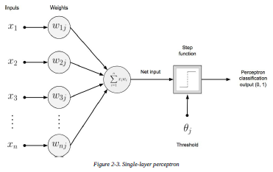
The Biological Neuron (Contd..)
Definition of the perceptron
The perceptron is a linear-model binary classifier with a simple input–output relationship as depicted in Fig.
It shows we’re summing n no. of inputs times their associated weights and then sending this “net input” to a step function with a defined threshold.
Typically with perceptrons, this is a step function with a threshold value of 0.5. This function will output a single binary value (0 or 1), depending on the input.

Slide 28

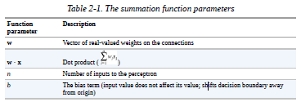
We can model the decision boundary and the classification output in the step function equation, as follows:
To produce the net input to the activation function,
we take the dot product of the input and the connection weights.
We see this summation in the left half of Fig. as the input to the summation function.
Table 2-1 provides an explanation of how the summation function is performed as well as note about the parameters involved in the summation function.

Slide 29
The output of the step function (activation function) is the output for the perceptron and gives us a classification of the input values.
If the bias value is negative, it forces the learned weights sum to be a much greater value to get a 1 classification output.
The bias term in this capacity moves the decision boundary around for the model.
Input values do not affect the bias term, but the bias term is learned through the perceptron learning algorithm.
As a basic linear classifier we consider the single-layer perceptron to be the simplest form of the family of feed-forward neural networks.

Slide 30
The perceptron learning algorithm
..
The algorithm will not terminate if the learning input is not linearly separable.
A linearly separable dataset is one for which we can find the values of a hyperplane that will cleanly divide the two classes of the dataset.
The perceptron learning algorithm initializes the weight vector with small random values or 0.0s at the beginning of training.
The perceptron learning algorithm takes each input record, as we can see in Fig., and computes the output classification to check against the actual classification label.
To produce the classification, the columns (features) are matched up to weights where n is the number of dimensions in both our input and weights.
The first input value is the bias input, which is always 1.0 because we don’t affect the bias input.
The first weight is our bias term in this diagram.
The dot product of the input vector and the weight vector gives us the input to our activation function, as we’ve previously discussed.
If the classification is correct, no weight changes are made. If the classification is incorrect, the weights are adjusted accordingly. Weights are updated between individual training examples in an “online learning” fashion. This loop continues until all of the input examples are correctly classified.

Slide 31
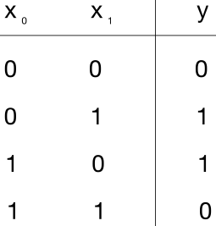
The perceptron learning algorithm (Contd..)
If the dataset is not linearly separable, the training algorithm will not terminate.
Figure 2-4 demonstrates a dataset that is not linearly separable,
the XOR logic function. A basic perceptron (single-layer variant) cannot solve
the XOR logic modeling problem, illustrating an early limitation of the
perceptron model.
Limitations of the early perceptron
After initial promise, the perceptron was found to be limited in the types of patterns it could recognize. The initial inability to solve nonlinear (e.g., datasets that are not linearly separable) problems was seen as a failure for the field of neural networks.
Figure 2-4. The XOR function

Slide 32
1.2 The Basic Architecture of Neural Networks (From Charu Agarwal)
In this section, we will introduce single-layer and multi-layer neural networks.
In the single layer network, a set of inputs is directly mapped to an output by using a generalized variation of a linear function.
This simple instantiation of a neural network is also referred to as the perceptron.
In multi-layer neural networks, the neurons are arranged in layered fashion, in which the input and output layers are separated by a group of hidden layers.
This layer-wise architecture of the neural network is also referred to as a feed-forward network. This section will discuss both single-layer and multi-layer networks.

Slide 33
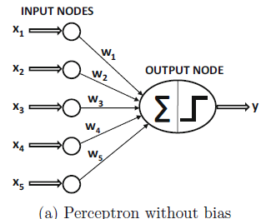
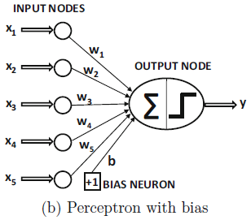
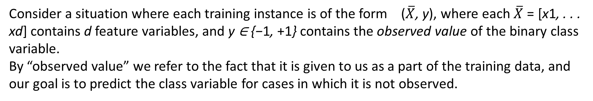
1.2 The Basic Architecture of Neural Networks
1.2.1 Single Computational Layer: The Perceptron
The simplest neural network is referred to as the perceptron.
This neural network contains a single input layer and an output node.
The basic architecture of the perceptron is shown in Figure 1.3(a).
Figure 1.3: The basic architecture of the perceptron
Consider a situation where each training instance is of the form ($\overline{X}$, y), where each $\overline{X}$ = [x1, . . . xd] contains d feature variables, and y ∈ {−1, +1} contains the observed value of the binary class variable.
By “observed value” we refer to the fact that it is given to us as a part of the training data, and our goal is to predict the class variable for cases in which it is not observed.

Slide 34
1.2 The Basic Architecture of Neural Networks
1.2.1 Single Computational Layer: The Perceptron (Contd..)
Figure 1.3: The basic architecture of the perceptron
For eg, in a credit-card fraud detection application, the features might represent various properties of a set of credit card transactions (e.g., amount and frequency of transactions), and the class variable might represent whether or not this set of transactions is fraudulent.
In this type of application, one would have historical cases in which the class variable is observed, and other (current) cases in which the class variable has not yet been observed but needs to be predicted.

Slide 35

1.2 The Basic Architecture of Neural Networks
1.2.1 Single Computational Layer: The Perceptron (Contd..)
In many settings, there is an invariant part of the prediction, which is referred to as the bias.
For eg, consider a setting in which the feature variables are mean centered, but the mean of the binary class prediction from {−1, +1} is not 0.
This will tend to occur in situations in which the binary class distribution is highly imbalanced.
In such a case, the aforementioned approach is not sufficient for prediction.
We need to incorporate an additional bias variable b that captures this invariant part of the prediction:
The bias can be incorporated as the weight of an edge by using a bias neuron.
This is achieved by adding a neuron that always transmits a value of 1 to the output node.
The weight of the edge connecting the bias neuron to the output node provides the bias variable.
Eq 1.2

Slide 36
Invariant definition: an entity , quantity , etc, that is unaltered by a particular transformation.
Use of additional input, which is called bias, of neuron improves properties of the neuron. It allows moving the threshold of activation function.
The bias value allows the activation function to be shifted to the left or right, to better fit the data. It is always 1.
A weight represent the strength of the connection between units. If the weight from node 1 to node 2 has greater magnitude, it means that neuron 1 has greater influence over neuron 2.
Weights in NN can, and will, become positive or negative depending on the training data.
The training function is the overall algorithm that is used to train the neural network to recognize a certain input and map it to an output.
The training process involves finding a set of weights in the network that proves to be good, or good enough, at solving the specific problem.
A learning function deals with individual weights and thresholds and decides how those would be manipulated.

Slide 37
1.2 The Basic Architecture of Neural Networks
1.2.1 Single Computational Layer: The Perceptron (Contd..)
An eg, of a bias neuron is shown in Fig.(b).
Biases will be incorporated with bias neurons.
The details of the training algorithms remain the same by simply treating the bias neurons like any other neuron with a fixed activation value of 1.
The perceptron algorithm was, therefore, heuristically designed to provide correctness.

Slide 38

1.2 The Basic Architecture of Neural Networks
1.2.1 Single Computational Layer: The Perceptron (Contd..)
Therefore, we can still write the goal of the perceptron algorithm in least-squares form with respect to all training instances in a data set D containing feature-label pairs:
This type of minimization objective function is also referred to as a loss function.
Neural network learning algorithms are formulated with the use of a loss function.
This loss function looks IIIr to like least squares regression.
and the corresponding loss is a smooth and continuous function of the variables.

Slide 39

1.2 The Basic Architecture of Neural Networks
1.2.1 Single Computational Layer: The Perceptron (Contd..)
On the other hand, for the least-squares form of the objective function, the sign function is non differentiable, with step-like jumps at specific points.
Furthermore, the sign function takes on constant values over large portions of the domain, and therefore the exact gradient takes on zero values at differentiable points.
This results in a staircase-like loss surface, which is not suitable for gradient-descent.
The perceptron algorithm (implicitly) uses a smooth approximation of the gradient of this objective function with respect to each example:
Eq. 1.3

Slide 40
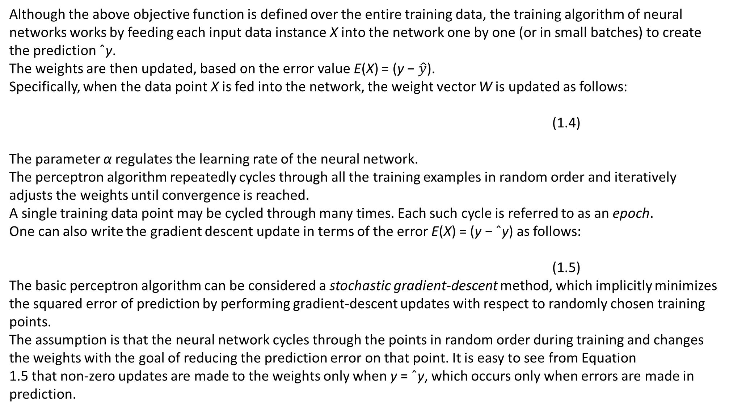
Although the above objective function is defined over the entire training data, the training algorithm of neural networks works by feeding each input data instance X into the network one by one (or in small batches) to create the prediction ˆy.
The weights are then updated, based on the error value E(X) = (y − $\hat{y}$).
Specifically, when the data point X is fed into the network, the weight vector W is updated as follows:
(1.4)
The parameter α regulates the learning rate of the neural network.
The perceptron algorithm repeatedly cycles through all the training examples in random order and iteratively adjusts the weights until convergence is reached.
A single training data point may be cycled through many times. Each such cycle is referred to as an epoch.
One can also write the gradient descent update in terms of the error E(X) = (y − ˆy) as follows:
(1.5)
The basic perceptron algorithm can be considered a stochastic gradient-descent method, which implicitly minimizes the squared error of prediction by performing gradient-descent updates with respect to randomly chosen training points.
The assumption is that the neural network cycles through the points in random order during training and changes the weights with the goal of reducing the prediction error on that point. It is easy to see from Equation
1.5 that non-zero updates are made to the weights only when y = ˆy, which occurs only when errors are made in prediction.

Slide 41
Working of NN
Activation Function: Sigmoid ReLU
Back Propagation
Multilayer NN
Optimizer: Gradient descent
Chain Rule of Differentiation
Vanishing Gradient Problem
Exploding gradient problem

Slide 42
Video 1:
Mathematical solution by a School Girl
https://www.youtube.com/watch?v=ZzWaow1Rvho&list=PLxt59R_fWVzT9bDxA76AHm3ig0Gg9S3So&index=1
Next video:
Software installation
https://www.youtube.com/watch?v=PUHjqT3xcTs&list=PLxt59R_fWVzT9bDxA76AHm3ig0Gg9S3So&index=3
Next Video:
Coding a NN in Python
https://www.youtube.com/watch?v=gwitf7ABtK8&list=PLxt59R_fWVzT9bDxA76AHm3ig0Gg9S3So&index=4
https://www.youtube.com/watch?v=LSr96IZQknc&list=PLxt59R_fWVzT9bDxA76AHm3ig0Gg9S3So&index=12

Slide 43
Python is a Python is an interpreted, high-level, general-purpose programming language. Python is actually known for being easy to code.
Anaconda is a free and open-source Python distribution and collection of hundreds of packages related to data science, scientific programming, development and more. Python is included in the Anaconda distribution
Jupyter is a browser-based interpreter that allows you to interactively work with Python.
Keras is a powerful and easy-to-use free open source Python library for developing and evaluating deep learning models.
It wraps the efficient numerical computation libraries Theano and TensorFlow and allows you to define and train neural network models in just a few lines of code.

Slide 44
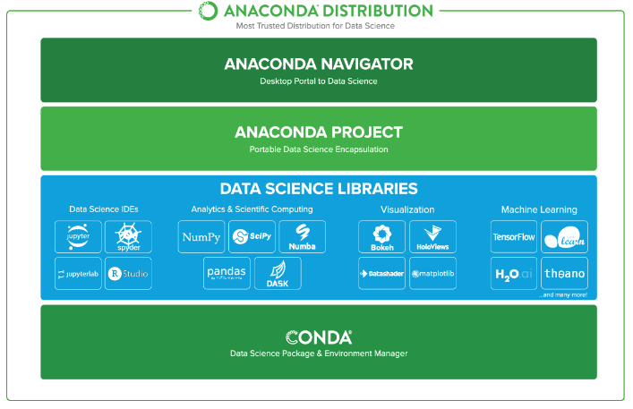
Anaconda is a free and open-source distribution of the Python and R programming languages for scientific computing (data science, machine learning applications, large-scale data processing, predictive analytics, etc.), that aims to simplify package management and deployment.

